Slide 1

NORTH WESTERN UNIVERSITY
Course Title : Algorithm. Course Code : CSE-2201.
Presentation Topic : Bubble Sort

Slide 2
Presentation
Submitted By :
Sajib Bhattacharjee
ID:20201070010
Section: B
Department of CSE
North Western University
Submitted To:
Sajib Chatterjee
Lecturer,
Department of CSE
North Western University
North Western University , Khulna.

Slide 3
Bubble Sort
Introduction:
Bubble sort is a simple sorting algorithm. This sorting algorithm is comparison-based algorithm in which each pair of adjacent elements is compared and the elements are swapped if they are not in order. This algorithm is not suitable for large data sets as its average and worst case complexity are of Ο(n²) where n is the number of items.

Slide 4
Bubble Sort Algorithm
begin BubbleSort(list)
for all elements of list
if list[i] > list[i+1]
swap(list[i], list[i+1])
end if
end for
return list
end BubbleSort

Slide 5
procedure bubbleSort( list : array of items )
loop = list.count;
for i = 0 to loop-1 do:
swapped = false
for j = 0 to loop-1 do:
/* compare the adjacent elements */
if list[j] > list[j+1] then
/* swap them */
swap( list[j], list[j+1] )
swapped = true
end if

Slide 6
end for
/*if no number was swapped that means array is sorted now, break the loop.*/
if(not swapped) then
break
end if
end for
end procedure return list

Slide 7
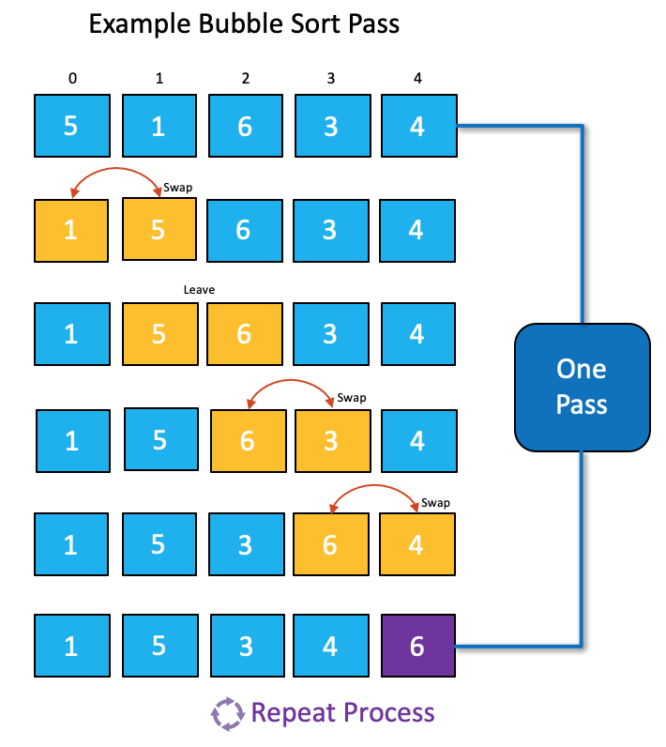
Example:

Slide 8
Thank You

